Slide 1
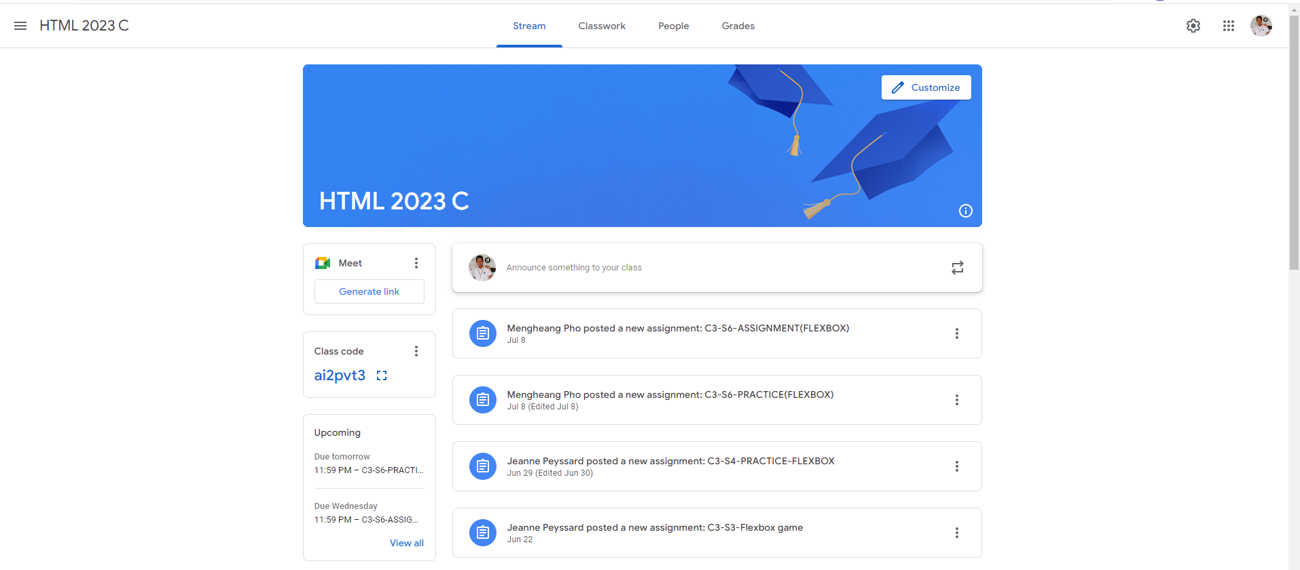
Identify root components of website below

Slide 2
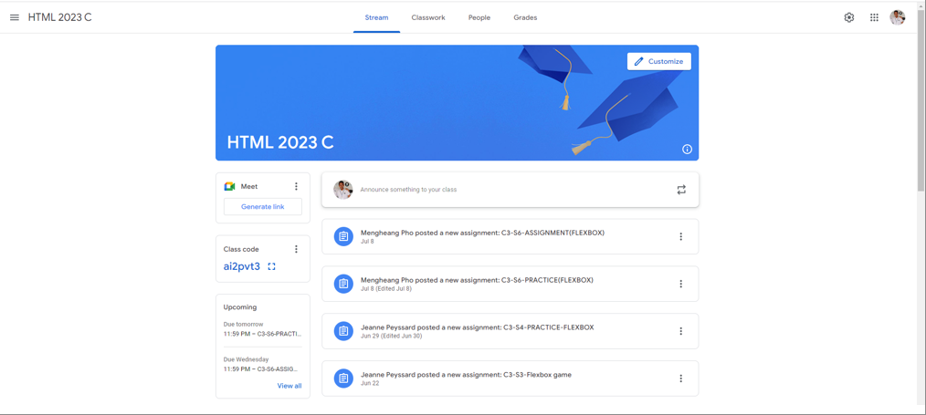
Identify for the root
Flex:0.5
Nav
Flex:1
Header
Flex:2
Container
Display: flex;

Slide 3
Identify for the Nav
Nav-left
Nav-center
Nav-right
icon
text
text
text
text
text
icon
icon
icon
Display: flex;

Slide 4
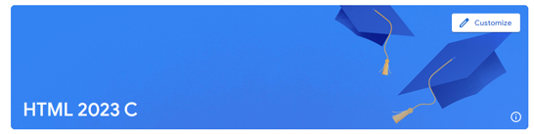
Identify for the Header
Header
Header-top
Display: flex;
Header-bottom

Slide 5
Identify for the Header
Header
Header-top
Button

Slide 6
Identify for the Header
Header
Header-bottom
text
icon

Slide 7
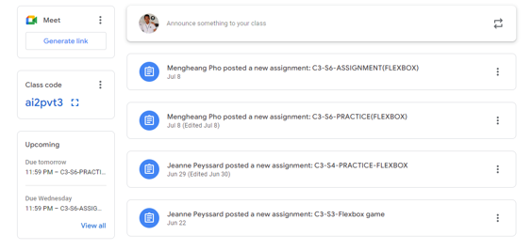
Identify for the Container
Display: flex;
Container-left
Container-right

Slide 8
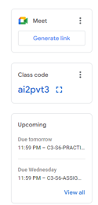
Identify for the Container
Container-left
Card1
Card2
Display: flex;
Card3

Slide 9
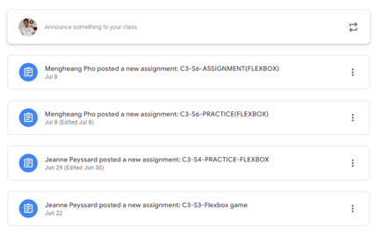
Identify for the Container
Container-right
Card1
Card2
Card3
Card4
Display: flex;
Card5

